Slide 1
2021-1학기 BK인턴
이성온 교수님
전자공학부
18 우희진
2021.01.25

Slide 2
목차
[논문 리뷰] Accurate Image Super-Resolution Using Very Deep Convolutional Networks
Introduction
Related Work ( Convolutional Network for Image Super-Resolution)
Proposed Method
( Residual- Learning, High Learning Rates for Very Deep Networks, Adjustable Gradient Clipping)
Understanding Properties
Conclusion

Slide 3
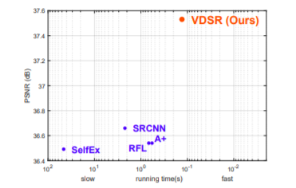
Introduction
SRCNN은 SR 문제에 대해서 상당한 효과를 가져옴
그러나 3가지의 한계점을 야기함.
Small image context에 의존
훈련 convergences가 너무 느림
Network는 오직 single scale만 작동.
Context : contextual information spread over very large image regions
Convergence : speed up train --> residual-learning CNN and extremely high learning rates
Scale Factor : a single convolutional network is sufficient for multi-scale-factor super-resolution.
해결방안

Slide 4
Related Work
Convolutional Network for Image Supper-Resolution
Model
- depth를 증가시키면 performance도 향상 된다.
- 20 layer 사용( 3 x 3 for each layer)
- (41 x 41) information used for reconstruction
Training
- network models the residual images
(훨씬 더 나은 정확도로 더 빠르게 convergence 가능)
Scale
-design and train a single network to handle scale SR problem efficiently.
-for three scales factors(x2,3,4)
Output image는 Input image와 같은 size (모든 layer마다 0을 padding)
--> 모든 layer에 대해 동일한 learning rates

Slide 5
Proposed Method
Proposed Network
Input of size (n+1)x(n+1) , receptive field size
n x n
-->output image
1 x 1
모든 feature map의 size 동일하게 유지.
Convolution 앞에
0을 붙인다.
Boundary pixel도 예측 가능해짐
모든 layer가 하나의 learning rate를 사용해도 충분,
학습시킬 parameter 수 줄어 들음
--> 학습 속도 증가

Slide 6
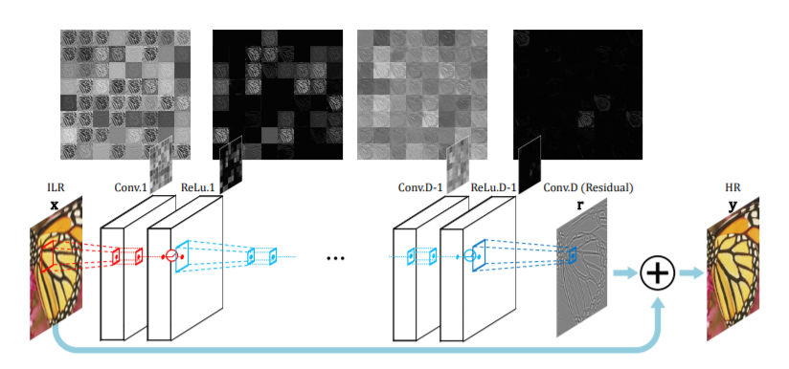
Proposed Method
Training

Slide 7
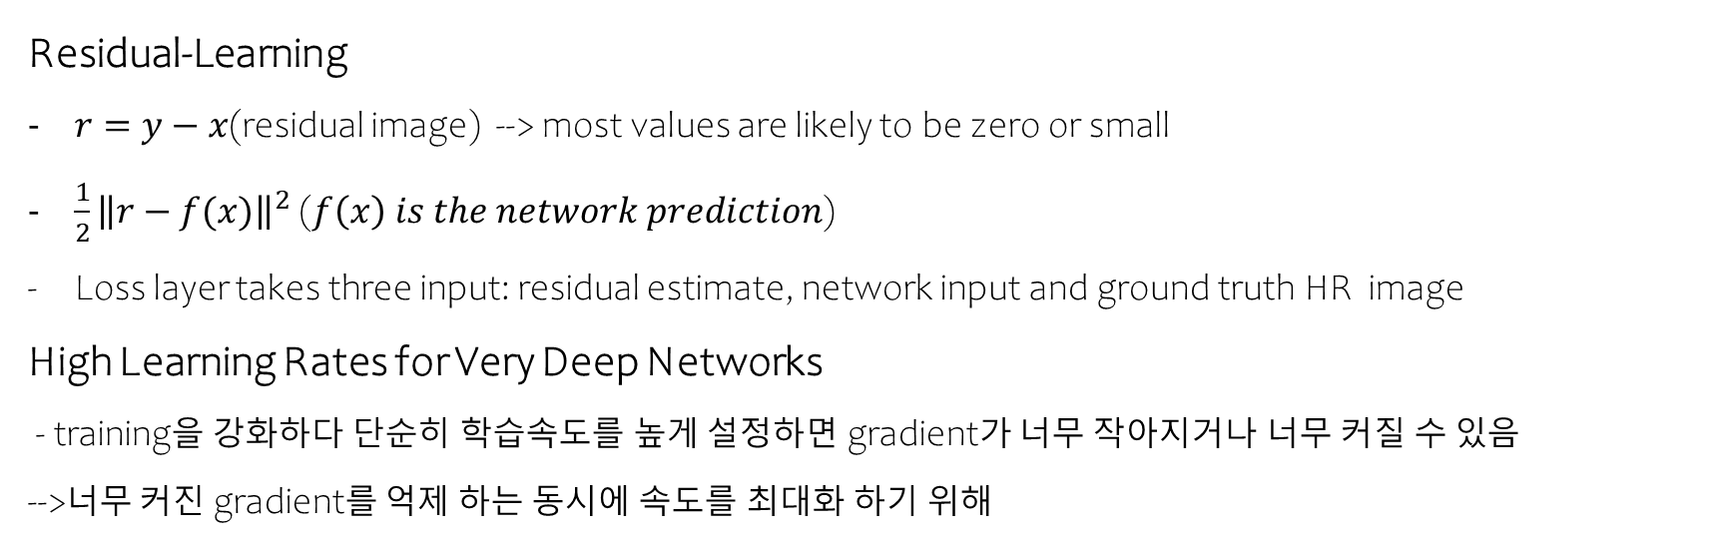
Proposed Method
Training
Residual-Learning
$r=y−x$(residual image) --> most values are likely to be zero or small
$\frac{1}{2}{\left\|r−f(x)\right\|}^{2}$($f\left(x\right) is the network prediction$)
Loss layer takes three input: residual estimate, network input and ground truth HR image
High Learning Rates for Very Deep Networks
- training을 강화하다 단순히 학습속도를 높게 설정하면 gradient가 너무 작아지거나 너무 커질 수 있음
-->너무 커진 gradient를 억제 하는 동시에 속도를 최대화 하기 위해

Slide 8

Proposed Method
Training
Adjustable Gradient Clipping
Limit gradients [$−θ,θ]$
gradient exploding를 피하기 위해 $θ 조$절.
Adjustable gradient clipping -->$\left[−\frac{θ}{γ},\frac{θ}{γ}\right]$($γ$ = current learning rate)
학습 속도 극대화하면서 training 시간 단축
Multi-Scale
Trian multi – scale model
Training datasets for several specified scales combined into one big datasets

Slide 9
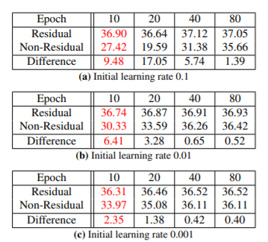
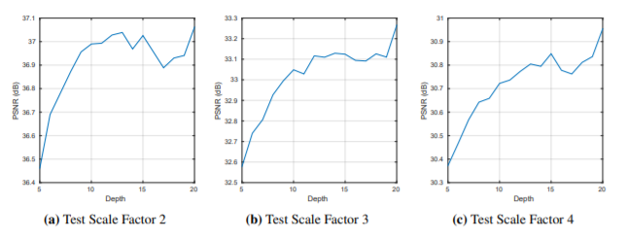
Understanding Properties
The Deeper, the Better
- Use filters of the same 3 x 3 all layers
- depth D network 커질수록 receptive field (2D+1)X(2D+1)로 증가
- A large receptive field means the network can use mean more context to predict image details
- Collecting and analyzing more neighbor pixels give more clues.

Slide 10
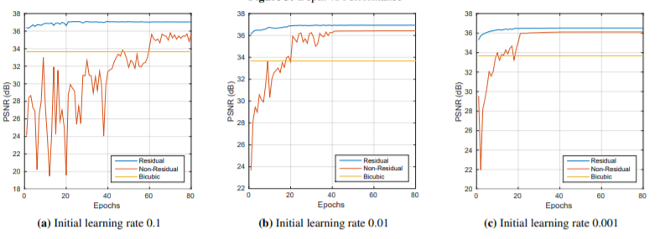
Understanding Properties
2) Residual - Learning
This residual network converges much faster
At convergence, the residual network shows superior performance.

Slide 11

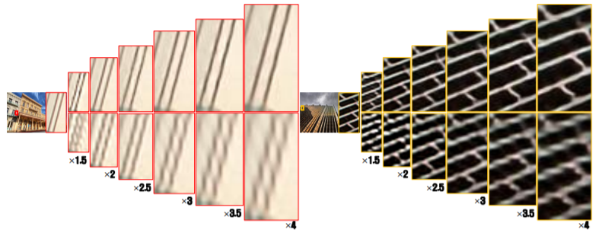
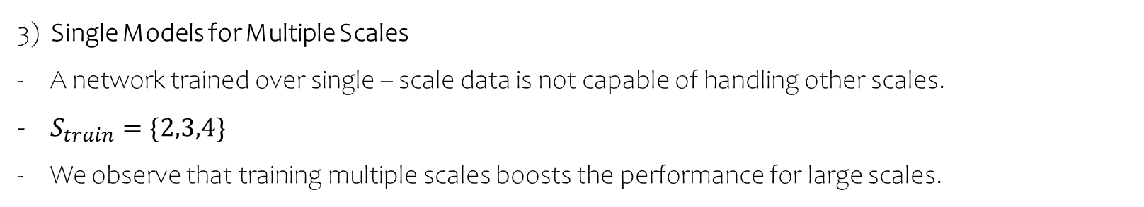
Understanding Properties
3) Single Models for Multiple Scales
A network trained over single – scale data is not capable of handling other scales.
$S_{train}=\{2,3,4\}$
We observe that training multiple scales boosts the performance for large scales.

Slide 12
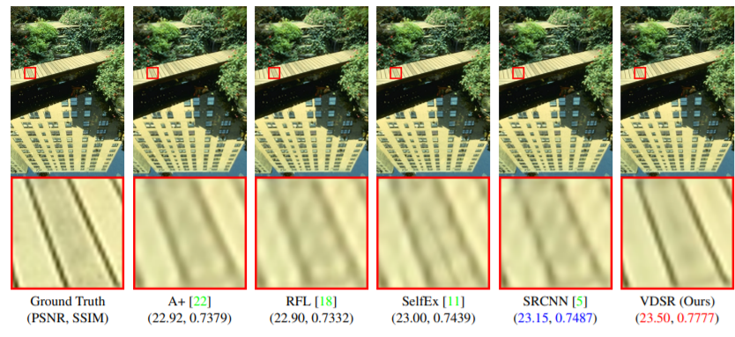
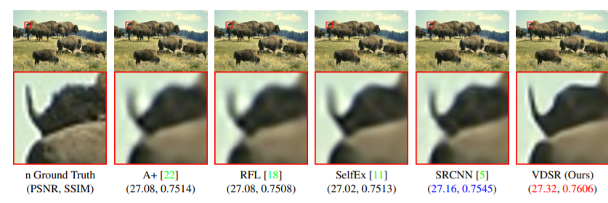
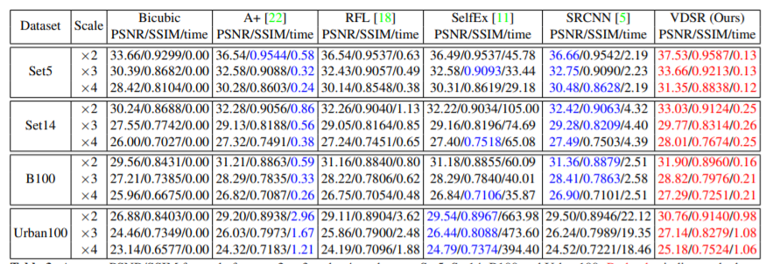
Conclusion

